Slide 1
Making Stuff in Excel

Slide 2
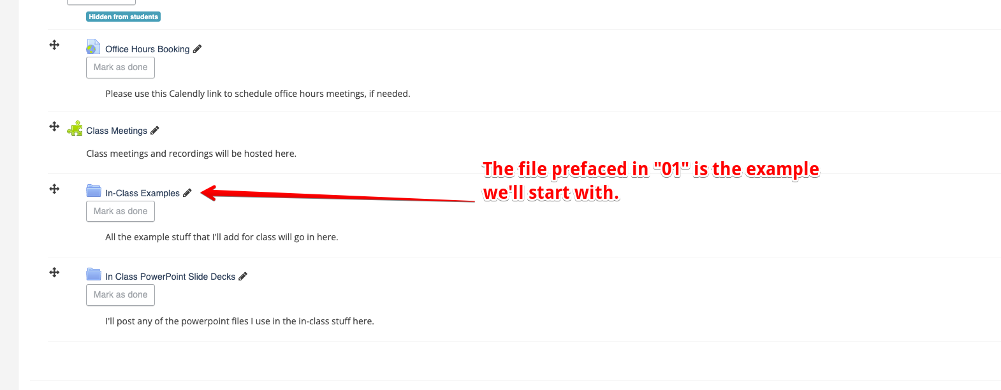
Today
Skills for Excel development.
Spreadsheet structure.
Complex/compound formulas.
Documentation.
Troubleshooting.
Referencing.

Slide 3
Using Excel for Fun and Profit
Excel is one of the most commonly used tools in offices for all sorts of things.
Both for good, and for ill.
Excel is also the largest chunk of this course.
If you’re going to be an accountant or similar, you’re obsessed with Excel.
Creating useful things in Excel can sometimes get complex.
Having some troubleshooting skills and taking care in design can make things easier.
Translate our ideas, accurately, to a spreadsheet.
Create things that are easy to maintain.
Work in a way that allows us to find and correct errors.

Slide 4
Data Basics
We’ll deal with data, as it is used for “data analytics” type of tasks, over the length of this course.
Some key ideas are:
Table/spreadsheet – a list of “things” of a certain type.
Row – one instance, or example of that type of thing.
Column – an attribute, or thing that we can know about whatever the “thing” is that’s in our data.
Data in this format is called a “datasheet”.

Slide 5
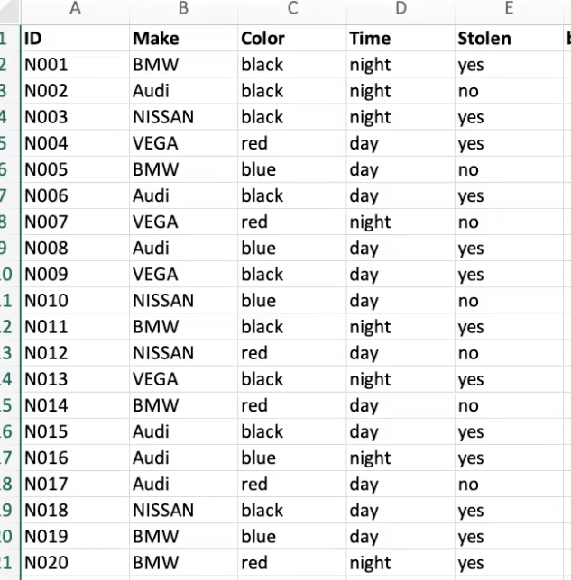
Example Data
The data that we’ll use first is cars, and which were stolen:
Table – this is a list of cars.
Row – each row is one car.
Columns – each column is one thing we know.

Slide 6
Formula Construction
Doing complex things often requires multipart or compound formulas.
Attempting to write a complex formula, with multiple parts, can be challenging to do all at once, especially if this is new to you.
In many cases we can simply the process by breaking complex things into more simple components, testing each on its own, then combining them:
Work backwards from what you want to figure out.
At each stage ask, “what do I need to know to figure this out”?
Eventually we’ll get to things that we can or do know.

Slide 7
Example
Suppose I want a formula that prints Yes or No for if a car was stolen at night…
Goal: if the car was stollen at night, print ”yes”, if not, print “no”.
Was the car stolen at all? (Part 1)
Does the stolen column = “yes”?
Was the time night? (Part 2)
Is the time column = “night”?
Now I have all that I need to figure out the answer, I need to figure out how to combine it to a final answer:
If Part 1 AND Part 2 are both “yes”, then print “yes”; anything else, print “no”.
Now we just need to figure out how to do it in Excel.

Slide 8
Chart the Influence
We can breakdown the “what do I need” question in several ways.
One is an influence chart.
We’ll do this more later…
Working backwards from the final goal, what do I need to answer this question?
Make the breakdowns as simple as possible.
Each layer to the left makes the question simpler.
Eventually we hit things that we can know.
Was stolen?
Print yes/no
Was stolen at night?
Was night?

Slide 9
Pseudocode
The last slide is an example of something called pseudocode, or writing out what we want to do in some formular or programming language, in plain language.
We broke down our problem to needing a few things:
Is it stolen? (Check if the value in a column is equal to some other value)
Was it night? (Check if the value in a column is equal to some other value)
Are these things both true? (Calculate an “and” comparison)
If they are, print “yes”; if not, print “no”. (Do something based on a condition)
Even if we don’t know how to do any of these things in Excel, we can look them up:
Each action is unitary – it is one specific thing. We can look in help or Google each one.
Each thing can be checked individually, to ensure we’ve done it correctly.

Slide 10
Documentation
Once we know specifically what we need to do, we can look up how to do it.
Excel help files, Google, Youtube, etc… all have directions that will detail the mechanics of doing anything we can think of in Excel.
The key step is that we can break our overall goal into individual actions.
We can look up how to do each action, then apply that to our scenario.
If you can reliably break down larger problems and look up how to do each step on your own, you can do pretty much anything you need to do.
There are 1000s of things you can do in Excel, it’s impossible to remember them all.

Slide 11
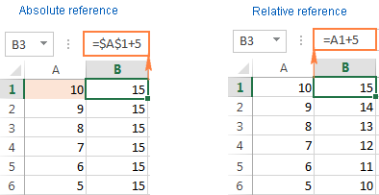
Referencing
One point that is very helpful when doing more complex things is using the correct reference to refer to cells.
We can use absolute or relative references, and you can also give cells names.
Absolute references refer to one cell, and never change.
Relative references refer to a cell that is some offset from a current position.
Naming cells can give us an easy to remember shortcut.
Being comfortable with this will make it far easier to find errors.
References, either the cell or row part, can be made absolute with a $:
$A$2 will always refer to cell A2.

Slide 12
Keep ‘em Separated
Another thing that can make creating and maintaining complex sheets easier is to separate the different types of data, and isolate the inputs.
Use variables, not literals (raw values) in your calculations.
This allows us to make changes more easily, with less opportunity for mistakes.
Isolate parameters (user inputs) in the sheet.
Anything that we are entering as new information should be separated.
Overall, we want the data in one place, our calculations in another, and inputs in another.
This will be more relevant soon, but it is good to keep in mind.

Slide 13
Conclusion
All of these things are more guidelines than strict instructions.
Good, organized practices will make it much easier to deal with more complex things later.
The most important things that we can learn if using Excel, or any other similar technology, are to be able to look up how to do what we want, and how to correct errors.
If we can narrow down what we want to do conceptually, we can look up how to do it.
If we can isolate what works and what doesn’t, we can correct mistakes as we go.
These skills aren’t things you need for some specific problem, they’re good tools that’ll make future problems easier to deal with.

